Slide 1

Cyber Attacks in Cloud Computing Environment
A PPT by,
Yazhiniyan.P - 2021115306

Slide 2
AUTHORS
Divyansha Garg
Reshu Agarwal
Amity Institute of Information Technology Amity University Noida.

Slide 3
Abstract Of This Paper
Cloud Computing Security Challenges : Cloud computing faces security challenges including cyberattacks, data vulnerabilities, and the necessity for thorough evaluation before adoption.
Types of Cyber Assaults Against Cloud Infrastructure : Cryptography breaches, DDoS attacks, and flooding pose significant threats to cloud infrastructure, highlighting the need for robust security measures.
Addressing Cloud Security Issues : Remedies for cloud security issues must be pursued to safeguard data integrity and availability, necessitating proactive measures and comprehensive protection strategies.

Slide 4
INTRODUCTION
In the realm of computing, cyber attacks pose a significant threat, particularly within cloud infrastructure. These assaults undermine trust in cloud services and compromise data security. Understanding the nature and implications of these threats is crucial for fortifying defenses. This introduction sets the stage for a deeper exploration into cyber attacks, emphasizing the imperative for proactive security measures in our interconnected
Digital landscape.

Slide 5
SECURITY OF DATA IN THE CLOUD
Effective cache management is vital in cloud computing to prevent data losses and ensure rapid retrieval.
Data protection is essential in all types of cloud environments (private, public, or hybrid).
Cloud service users should not assume automatic security for data, cache management, or disaster recovery.
Verify that cloud service providers offer necessary services for data cache security and possess expertise in relevant technologies.
Cloud storage providers offer encryption techniques for data security, with encrypted keys stored securely for user authentication.

Slide 6
THREATS IN CLOUD COMPUTING
A)Non-technical Threats To Cyber Security:
Evaluating dangers in cloud computing requires understanding key risk factors for businesses.
Wrong Passwords: Strict user password policies are essential for data protection, preventing easy cracking by modern password cracking software.
Physical Security: Ensuring robust physical security safeguards workers, assets, and critical data from unauthorized access.
Improper Destruction: Failure to securely destroy physical and electronic records poses risks of data recovery and misuse

Slide 7
B) Insecure Interfaces And Apis
Cloud computing customers utilize software interfaces or APIs to interact with cloud services.
Secure APIs are essential for both accessibility and security of cloud services.
These interfaces must prevent data breaches and losses by providing protection against both innocent and malicious attempts.

Slide 8
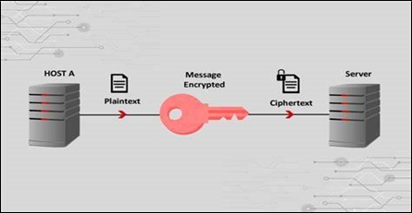
C) Cryptographic attacks
The most typical cryptanalytic assaults are three. They all rely on the cryptanalyst's thorough understanding of the employed encryption algorithm. Figure 5 shows Cryptographic attacks
Cryptographic attack

Slide 9
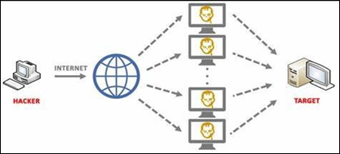
D) DoS / DDoS attack
Online attacks appear to have increased as a result of the Internet's rapid expansion during the past ten years. Attacks that target availability reduction include DoS (Denial of Service) attacks.
Such an attack may take many different forms, such as an assault on the physical IT environment, a network connection overload, or the exploitation of application flaws. Figure 6 shows DOS/DDOS attacks.
DOS/DDOS ATTACK

Slide 10
E) Syn Flood Attack
When a host sends out a large number of TCP/SYN packets, usually with a forged sender address, this is known as a syn flood. The server initiates a connection because each of these packets is interpreted as a request for a connection.
The server then responds with a TCP/SYN-ACK message and waits for a packet from the sender address to complete this (reply to the ACK Packet). Yet, the responses never materialise because the sender address is a hoax.
These partially open connections overburden the server's connection capacity, preventing it from responding to valid requests until the attack is over.

Slide 11
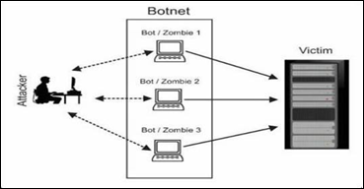
F. Botnet Attacks
Via a network of controlled computers, a method known as Botnet launches a DDoS assault. Bots are computer programmes that operate computers for predetermined goals.
Large numbers of bots provide computers the ability to build powerful tools for things like widely disseminating spam email, click fraud, installing malware, spreading viruses and worms, and DDoS attacks.

Slide 12
Conclusion
Collaborative efforts between cloud service providers and consumers are vital for safeguarding user data. Overreliance on passwords and encryption may not provide adequate protection against cyber threats. DDoS attacks and cryptographic vulnerabilities present significant risks to cloud systems. Proactive measures and vigilant monitoring are essential to address potential gaps in cloud security. Continued research and enhanced security measures are imperative to mitigate vulnerabilities and ensure the resilience of cloud computing infrastructure

Slide 13
REFERENCES
Link to this paper:
https://ieeexplore.ieee.org/stamp/stamp.jsp?tp=&arnumber=10192833
Related Papers:
http://ijeie.jalaxy.com.tw/contents/ijeie-v1-n2/ijeie-v1-n2.pdf#page=29

Slide 14
THANK YOU
BY :
YAZHINIYAN.P (2021115306)

